Slide 1

Elizabeth Aufzien, Sam Lipschitz, Joy Neuberger

Slide 2
Overview:
Our application
Background
UML Diagram
Gameplay
Testing Strategy
Live Demo of Test Suite
Code Coverage Reports
Line Coverage
Branch Coverage
Mutation Testing (attempt)
Faults we found
Summary of Results
Notes:
Joy

Slide 3
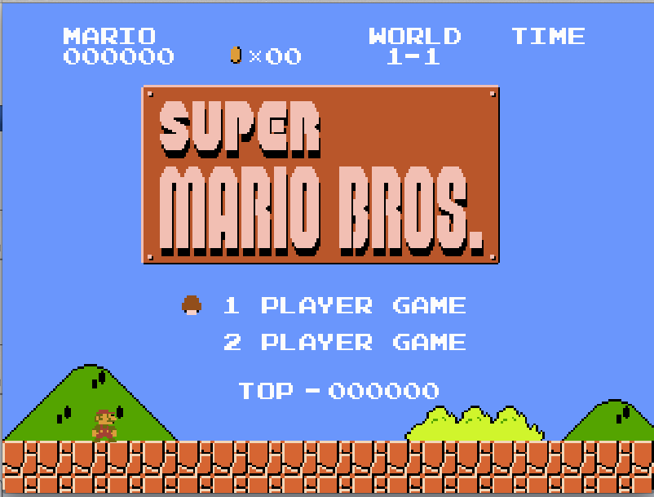
Our Application
A recreation of the first level of Super Mario Bros in Python using pygame
Notes:
Joy

Slide 4


Our Application: Background
Our app is a PC game
It runs on any platform supporting python and pygame (we upgraded it to use Python 3)
Potential/Active Users: Originally intended as a teaching tool, but it is used by many nostalgic young people trying to recreate the magic of their childhood
What technologies and programming language(s) does the app use?
Python 3
Pygame: a framework for implementing games in python
Notes:
Joy

Slide 5
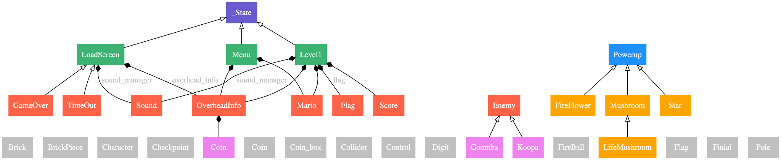
UML Diagram
Notes:
Joy

Slide 6
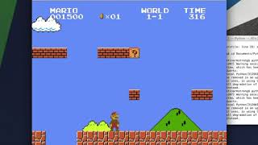
Gameplay Demo
Notes:
Sam

Slide 7
Testing Strategy
Technologies:
unittest (Python unit testing framework inspired by JUnit)
unittest Mock, MagicMock, and Patch functionalities
Approach
Unit testing for all components & utilities
Whitebox testing based on code
Blackbox testing based on comments specifying functionality
Interaction-based testing utilizing mocks
(in-progress) use mutation testing to make our test suite more robust
Notes:
Sam

Slide 8
Observations
“pass”-only methods
All constants were imported from a single file
Relative imports made testing difficult so we used setuptools to restructure
It’s a game, so clearly there’s some fuzziness with requirements, and the look/feel matters more than explicit requirements
Needed to utilize a lot of mocks - if we had written the code, we could have restructured it to make testing easier
Notes:
Sam

Slide 9
Notes:
Elizabeth

Slide 10
Coverage (in aggregate)
Line coverage: 98% of lines
Branch coverage: 95% of lines

Slide 11
Components Coverage
File | Line Coverage (%) | Branch Coverage (%)
bricks.py | 100% | 96%
castle_flag.py | 100% | 97%
checkpoint.py | 100% | 100%
coin.py | 100% | 100%
coin_box.py | 100% | 93%
collider.py | 100% | 100%
enemies.py | 100% | 96%
flagpole.py | 100% | 98%
flashing_coin.py | 100% | 91%
info.py | 100% | 98%
mario.py | 100% | 95%
powerups.py | 100% | 97%
score.py | 100% | 96%
Totals | 100% line coverage for components | 96% branch coverage for components
Notes:
Elizabeth

Slide 12
Utility Coverage
File | Line Coverage (%) | Branch Coverage (%)
constants.py | 100% | 100%
game_sound.py | 63% | 62%
main.py | not covered | not covered
setup.py | 100% | 100%
tools.py | 100% | 97%
Notes:
Elizabeth

Slide 13
Faults
Collision boxes are inaccurate
found in test_bricks, brick_pieces as the state brick.bumped is not set correctly
Mario fuzzes through the edge of components when he is jumping
found in test_mario, related to above issue
When you complete level 1, a game over page pops up.
visual inspection
Coins don’t update at the end of the game properly
found in overhead_info tests
Critiques:
There was a lack of error testing or checking for invalid input
Frequent use of hard coded constants (that were not in constants file)
Poor documentation on how to get the game running
Notes:
Elizabeth

Slide 14
Results: What we accomplished
Identified faults via visual inspection by playing the game
Designed a comprehensive test suite, giving more confidence that the game is implemented correctly
Achieved high level of coverage on all components & utilities
Used mocks to verify interactions were occurring correctly
Asserted that the correct images and animations were being rendered at the correct times & that correct soundtracks were played
Notes:
Elizabeth

Slide 15
What we learned
You can install your own packages using setuptools to avoid messy relative imports of components into test directories
How to conduct unit testing, integration testing and mutation testing with Python
Learned that many errors come from incorrectly implemented tests - careless use of self, not resetting parameters
Notes:
Elizabeth

Slide 16
Plans Going Forward
Achieve 100% branch coverage
Finish testing level1.py and main.py (which is the main class)
We waited to finish testing all components and utilities before testing these classes
Use mutation testing and analysis to make our test suite more robust (w/ MutPy)
Continue iterating on our existing tests to potentially reveal more faults!
Notes:
Elizabeth

Slide 17
Questions?
Notes:
Elizabeth

